Slide 1




Book Recommendation System
Kartikay Srivastava 2301640140096
Shivam Nishad 2301640140169
Yash Chaurasia 2301640140213

Slide 2


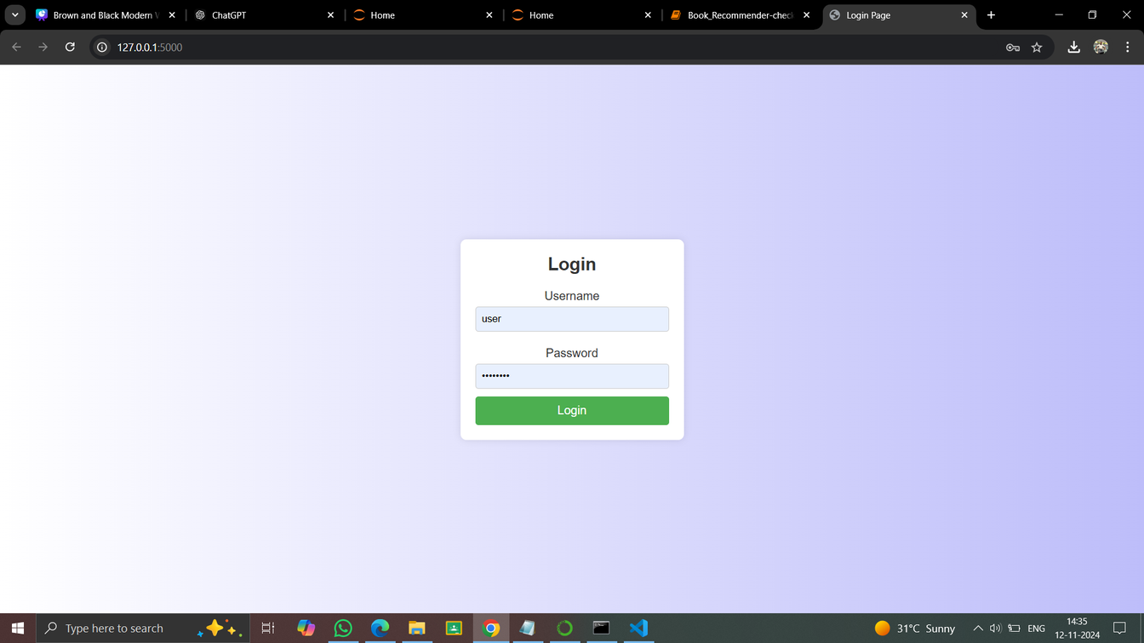

Introduction
In today's digital age, countless books across diverse genres make choosing the right read overwhelming. A Book Recommendation System provides an intelligent solution, guiding users to discover books tailored to their tastes and reading history. By using data-driven insights, it simplifies the selection process, enhancing the reader experience and helping users uncover new favorites that align with their interests.

Slide 3


Objective
The objective of this project is to design and implement a book recommendation system that assists college students and faculty in discovering relevant books based on individual preferences, academic requirements, and reading patterns. By leveraging machine learning algorithms and collaborative filtering techniques, the system will analyze user data, past interactions, and book characteristics to generate personalized recommendations. This solution aims to improve the user experience in academic and recreational reading, enhancing accessibility to valuable resources and fostering a more engaging reading culture within the college community.

Slide 4
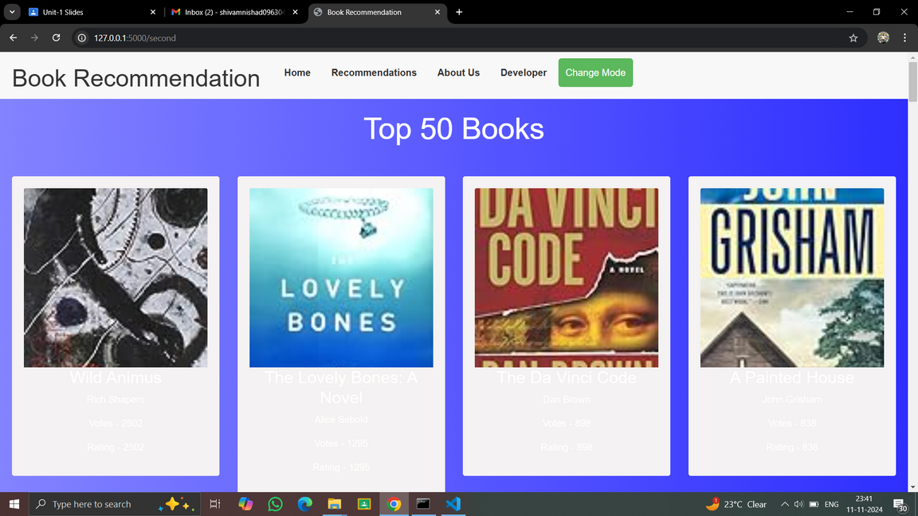
Methodology
The methodology for developing a book recommendation system in a college setting will include multiple stages, from data gathering to model development and evaluation. Below is a structured approach for building an effective recommendation system.
Requirement Analysis
Data Collection and Preprocessing
Exploratory Data Analysis (EDA)
Model Selection
Model Training and Optimization
System Implementation
Evaluation and Testing
Deployment and Maintenance
Documentation and Presentation

Slide 5
Methodology
Tools :
Programming Languages : Python, JavaScript
Frameworks and Libraries: Flask/Django, NumPy/Pandas, Scikit-Learn, TensorFlow/Keras (optional), Natural Language Toolkit (NLTK)/spaCy.
Database: MySQL, MongoDB.
Front-End Technologies: Flask, HTML5/CSS3/JavaScript.
Machine Learning Tools: Surprise, LightFM, Matplotlib/Seaborn.
Development and Version Control: Visual Studio Code,Anaconda, Jupiter

Slide 6
Methodology
Process
Implementation
Requirement Analysis
Data Collection and Preprocessing
Exploratory Data Analysis (EDA)
Model Selection
Model Training and Optimization
System Implementation
Evaluation and Testing
Deployment and Maintenance
Documentation and Presentation
Backend Setup
Recommendation Engine Development
API Creation
User Interface (UI)
Deployment and Integration
Continuous Learning and Feedback Loop

Slide 7
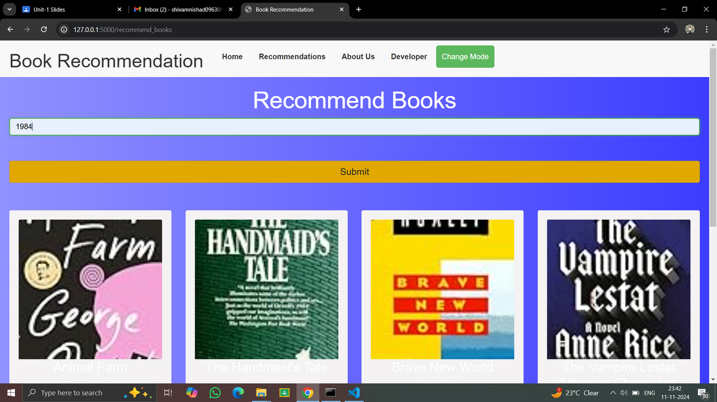
Result
import numpy as np
def recommend(book_name):
index = np.where(pt.index == book_name)[0][0]
similar_items = sorted(list(enumerate(similarity_score[index])), key=lambda x: x[1], reverse=True)[1:6]
data = []
for i in similar_items:
item = []
temp_df = books[books['Book-Title'] == pt.index[i[0]]].drop_duplicates('Book-Title')
item.append(temp_df['Book-Title'].values[0])
item.append(temp_df['Book-Author'].values[0])
item.append(temp_df['Image-URL-M'].values[0])
data.append(item)
return data

Slide 8
Analysis
User Interaction Patterns: Analyze user interaction data (e.g., book ratings, views, bookmarks) to identify trends, such as popular genres, commonly liked books, or frequently read authors. This helps refine the recommendation logic and highlight areas of high demand.
User Profiles: Segment users based on preferences or demographics (e.g., students, faculty) to identify distinct reading patterns across user groups. This analysis can inform personalized recommendation strategies.
Book Metadata Analysis: Examine the metadata of books (such as genre, keywords, author) to identify similarities and correlations that can improve content-based recommendations.

Slide 9
Conclusion
The analysis demonstrates that the implemented book recommendation system effectively meets its objectives by providing personalized, relevant, and diverse book suggestions to the college community. Through comprehensive data analysis, rigorous model evaluation, and positive user feedback, the system proves to be a valuable tool in enhancing academic and recreational reading experiences. Ongoing monitoring and iterative improvements will ensure the system remains responsive to user needs and continues to deliver high-quality recommendations.

Slide 10
Thank You

